Slide 1
E-HEALTH MANAGEMENT SYSTEM
TEAM-07
P. RAZIYA (22R11A05H0)
SK. SANIA (22R11A05H6)
G. SREEJA (23R15A0517)

Slide 2
CONTENTS
INTRODUCTION
EXISTING SYSTEM
PROPOSED SYSTEMD
FEASIBILITY
MODULE
SYSTEM ARCHITECTURE
PROGRAMERS VIEW
CUSTOMERS VIEWS
CONCLUSION

Slide 3
INTRODUCTION
The E-Healthcare Management System is a comprehensive solution that streamlines healthcare services in the digital era. It bridges the gap between healthcare providers and patients, offering features like Electronic Health Records, appointment scheduling, prescription management, and telemedicine services. It improves data management, reduces administrative overhead, and ensures timely healthcare regardless of geographical constraints. With a user-friendly interface and secure data storage, it enhances healthcare accessibility, efficiency, and patient outcomes in the evolving landscape of digital health.

Slide 4
EXISTING SYSTEM
Integration of Corporate Medicare centres is very difficultt.
In most of the cases the database is similar from one hospital to another hospital.
Lack of generic and unique model we have to implement the same set of data model for every newly established Medicare Centre.
It is very difficult to analyse the usage percentage of hospital resources, Bed occupation Ratio, Administration, Laboratory information even in a single centre.

Slide 5
PROPOSED SYSTEM FEATURES :
In this project we are trying to implement which parts of a data-mining project for hospital management are equal or highly similar across different hospitals (at least in the same national healthcare system).
This allows us to design several data mining modules, which can be portable across several hospitals, thus dramatically reducing the time to implement a data-mining program in a new hospital.

Slide 6
FEASIBILITY
Feasibility study should be performed on the basis of various criteria and parameters.
The various feasibility studies are:
1.Economic Feasibility
Operational Feasibility
Technical Feasibility

Slide 7
MODULE
This project is very helpful to both Medicare staff as well as to the public.
It is having mainly two modules:
Administration module:
Administration module mainly deals with the all the Medicare management such as department, ward, staff, inventory management of the Medicare.
Client module:
Client module mainly includes doctors , patients etc.

Slide 8
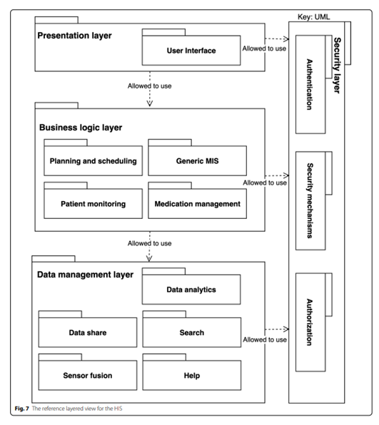
SYSTEM ARCHITECTURE

Slide 9

PROGRAMMERS VIEW

Slide 10
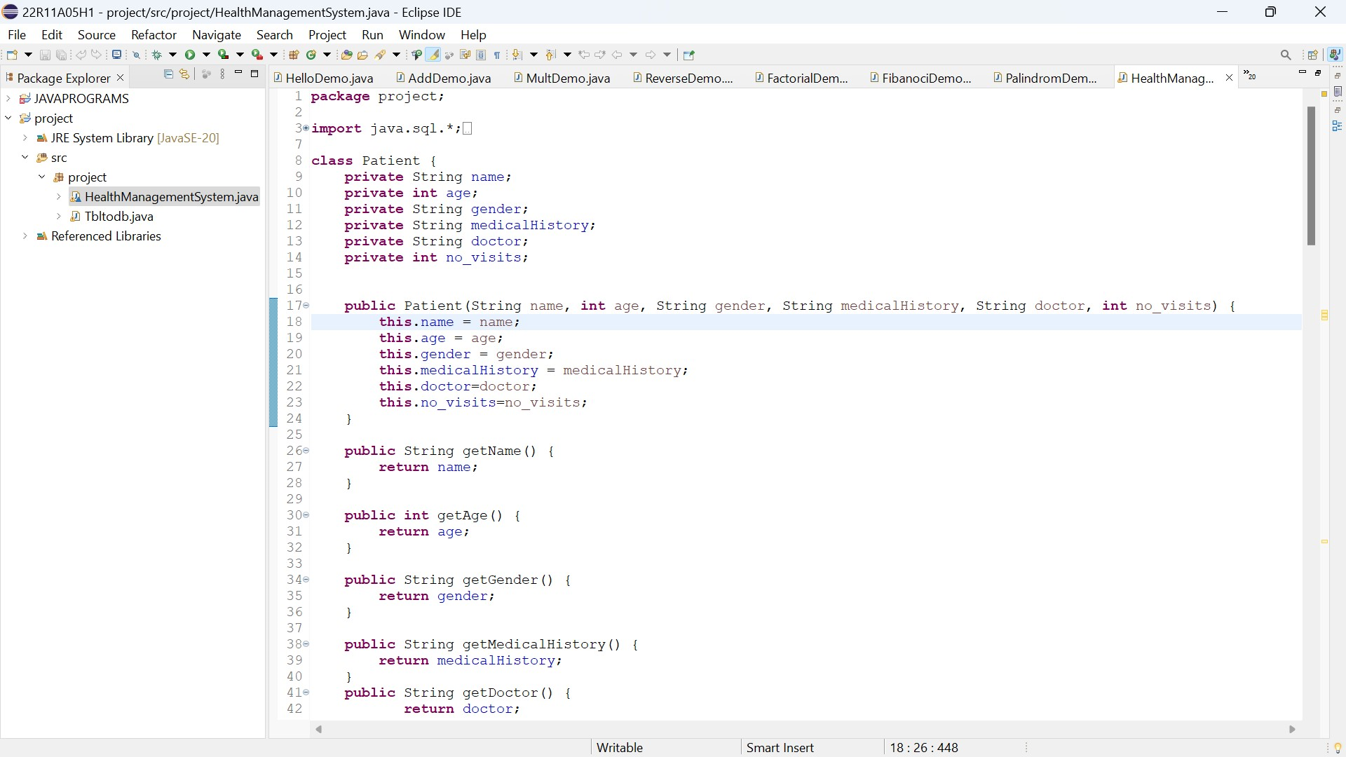

Slide 11
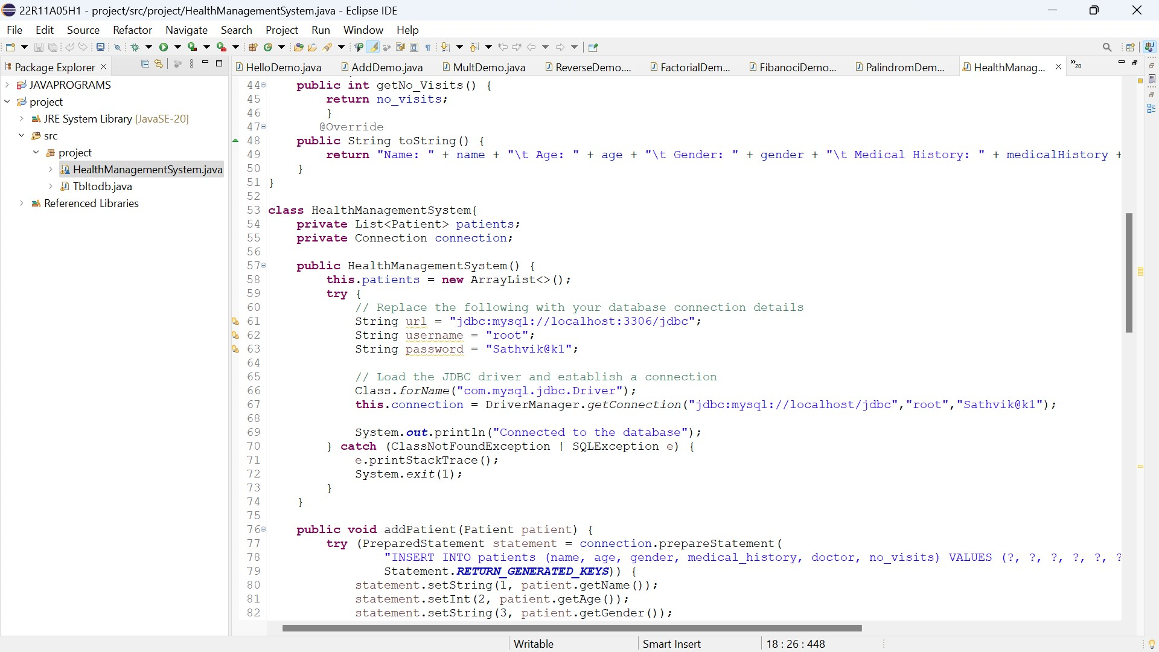

Slide 12
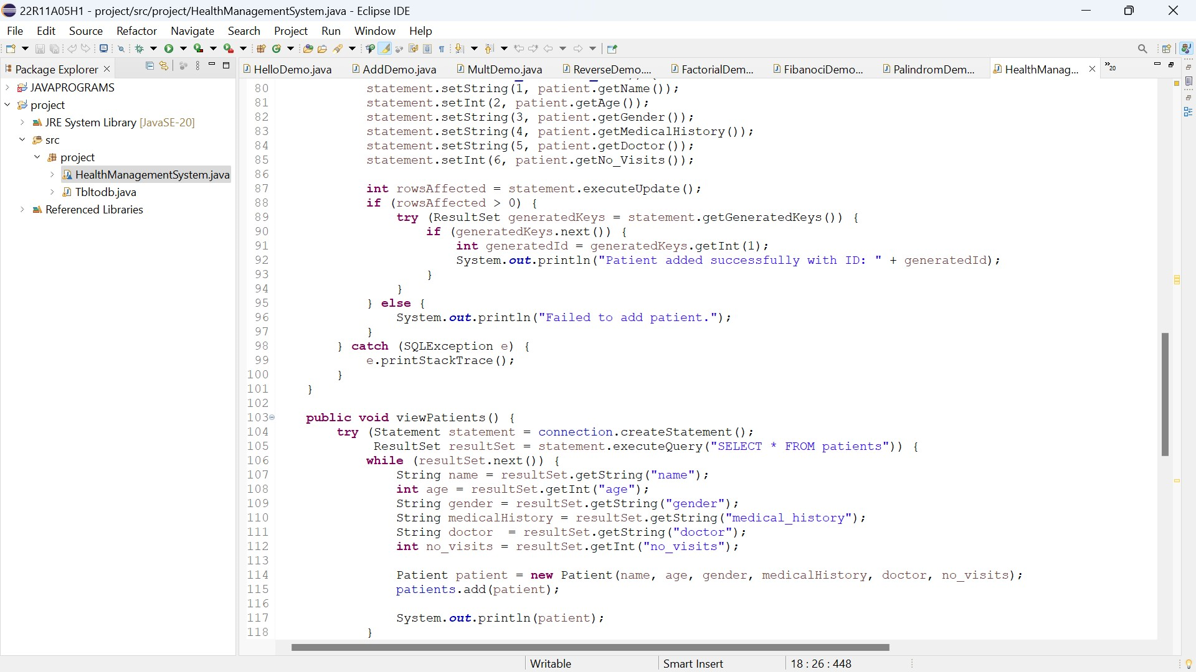

Slide 13
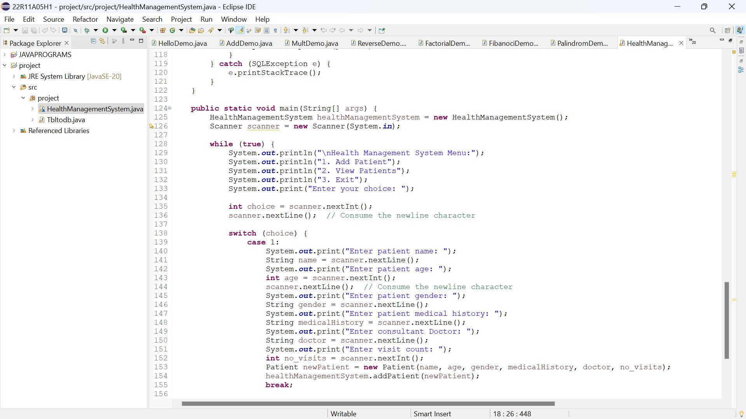

Slide 14
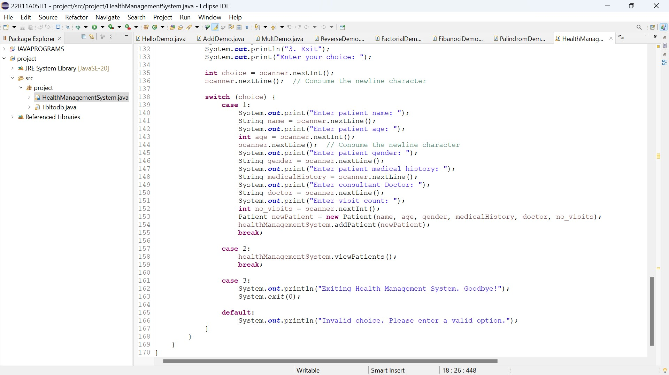

Slide 15

OUTPUT
CUSTOMER VIEW

Slide 16
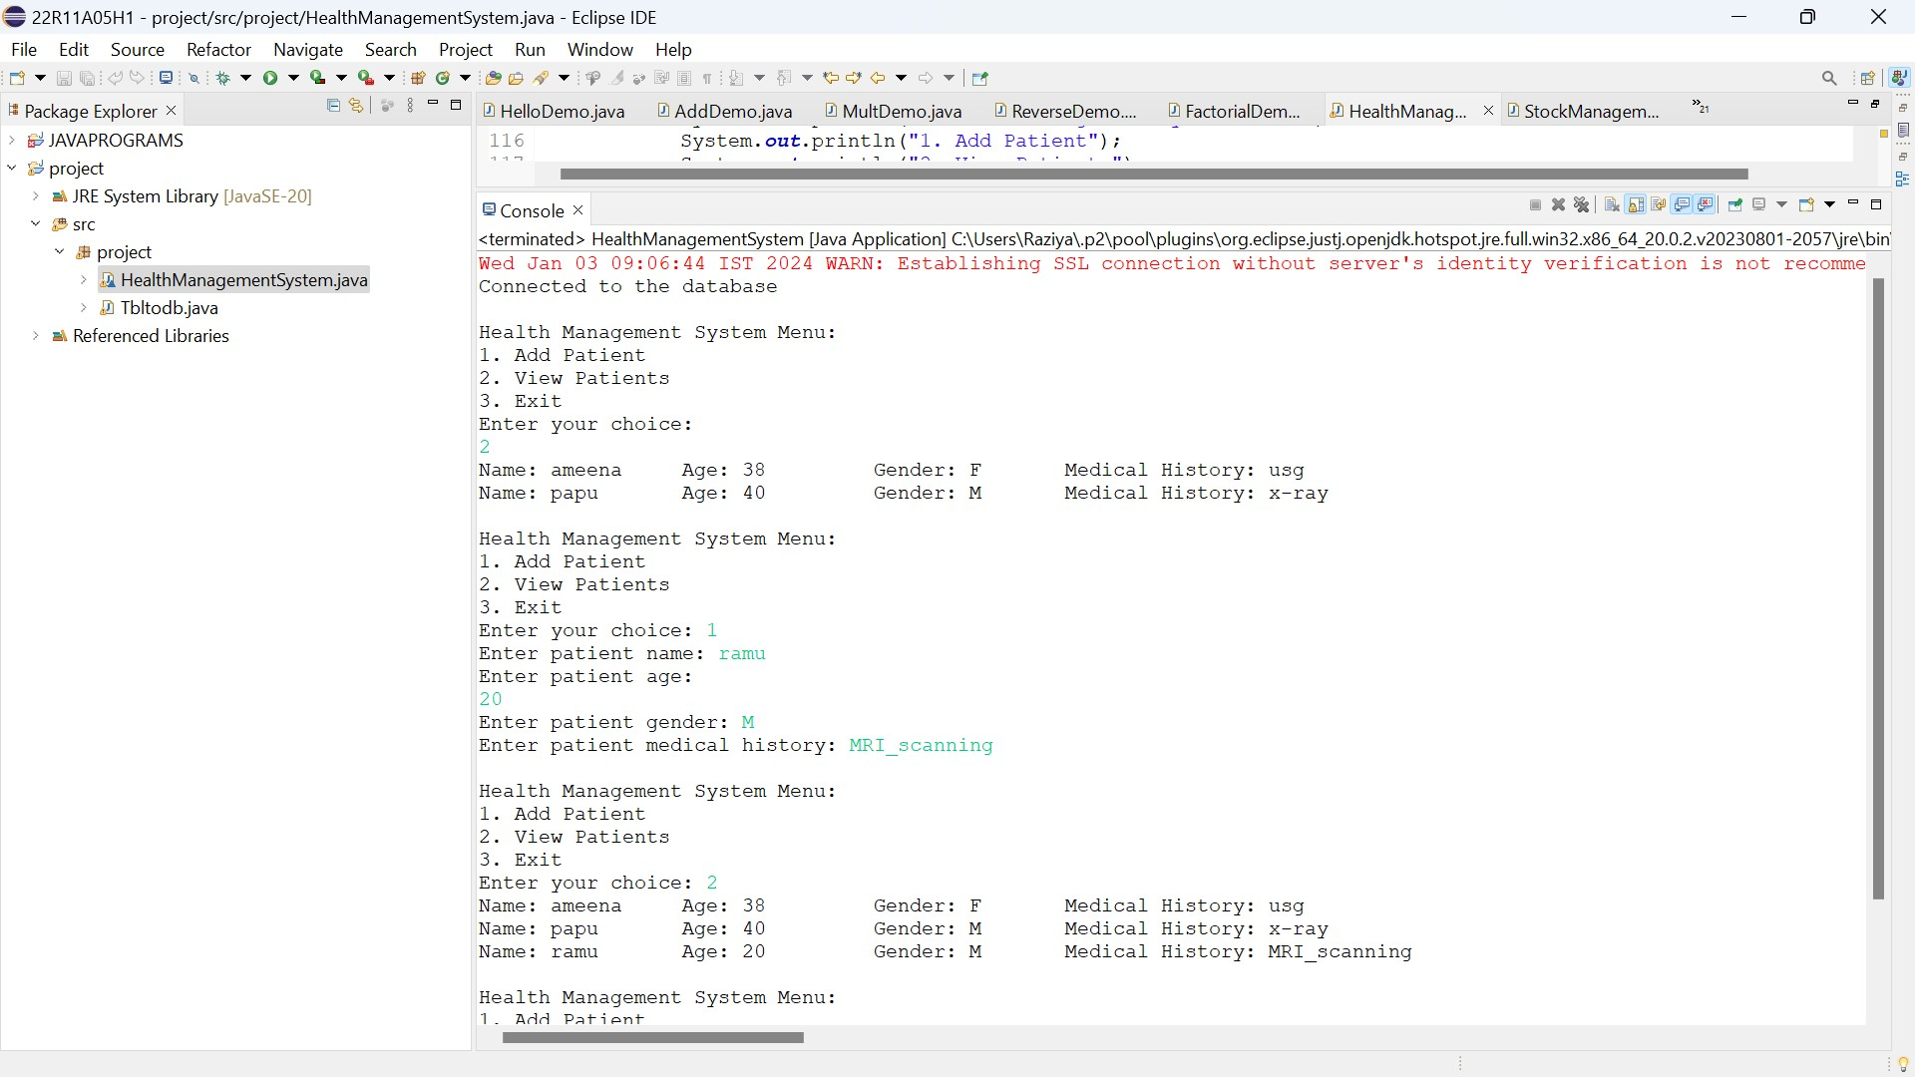

Slide 17
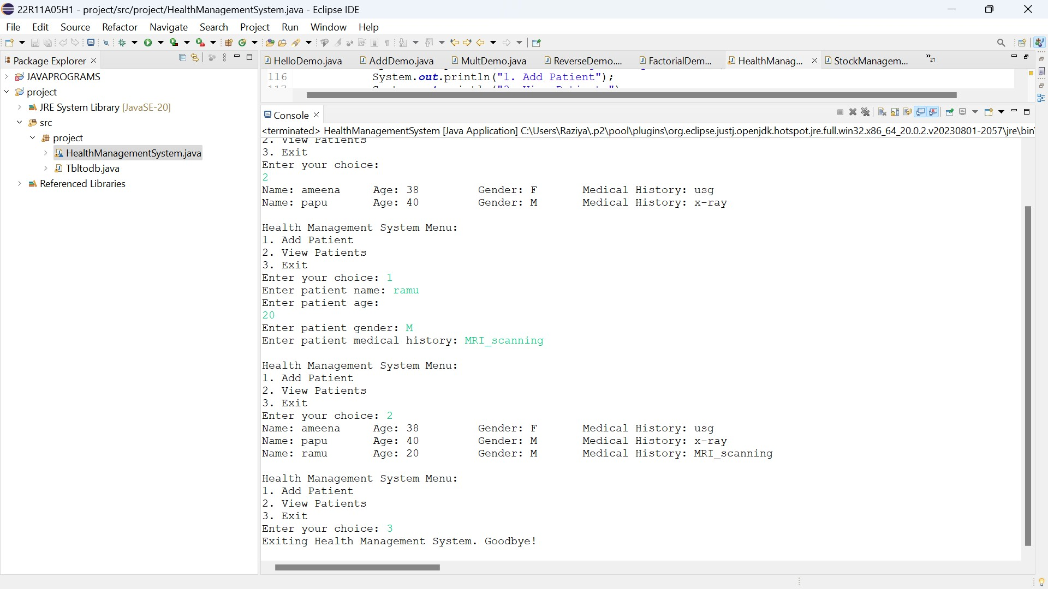

Slide 18
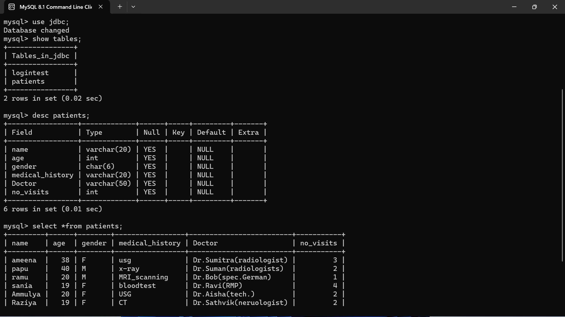

Slide 19
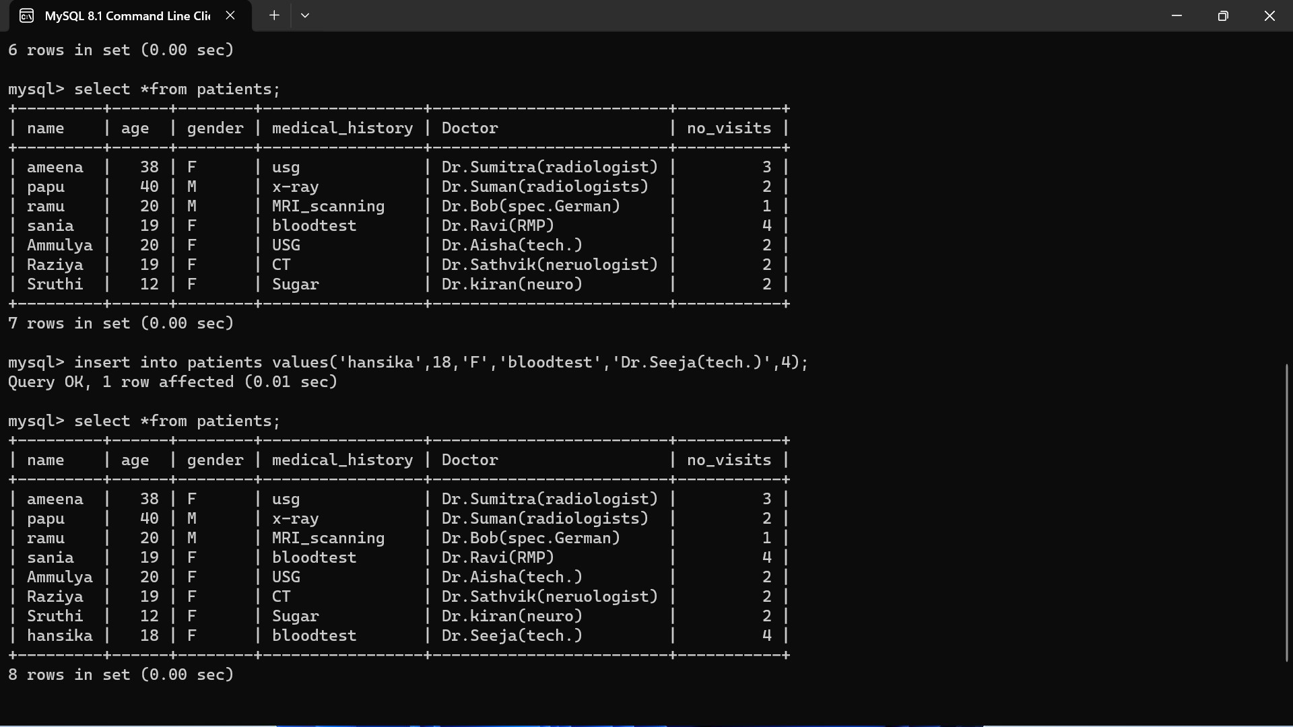

Slide 20
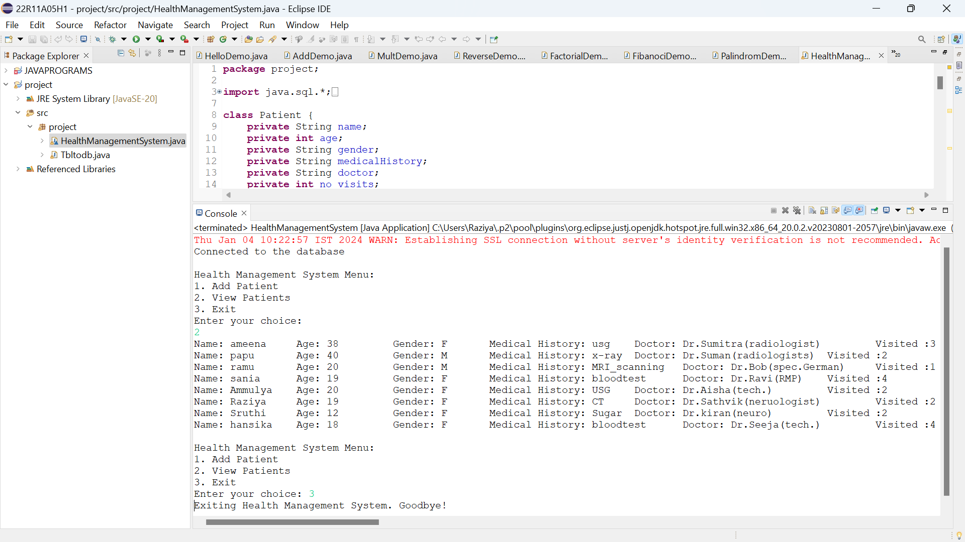

Slide 21
CONCLUSION
The growing quality demand in the hospital sector makes it necessary to exploit the whole potential of stored data efficiently, not only the clinical data, in order to improve diagnoses and treatments, but also on management, in order to minimize costs and improve the care given to the patients.
In this sense, Data Mining (DM) can contribute with important benefits to the health sector, as a fundamental tool to analyze the data gathered by hospital information systems (HIS) and obtain models and patterns which can improve patient assistance and a better use of resources and pharmaceutical expense.

Slide 23


